Slide 1

DHPoly

Slide 2
Index
Business
Technical Abilities
Quality

Slide 3
Index
Business
Introduction
Vision
Use Case
Scope
Scrum
Workflow
Project Methodology
Quality
Technical Abilities

Slide 4
Our Team:
Alexander Busch | Sven Köhler | Rico Kritzer
Project Manager Designer | Tool Specialist Requirements Specifier Tester | Head Developer Software-Designer

Slide 5
Our Vision
Monopoly
Luck
Ressources
Events

Slide 6
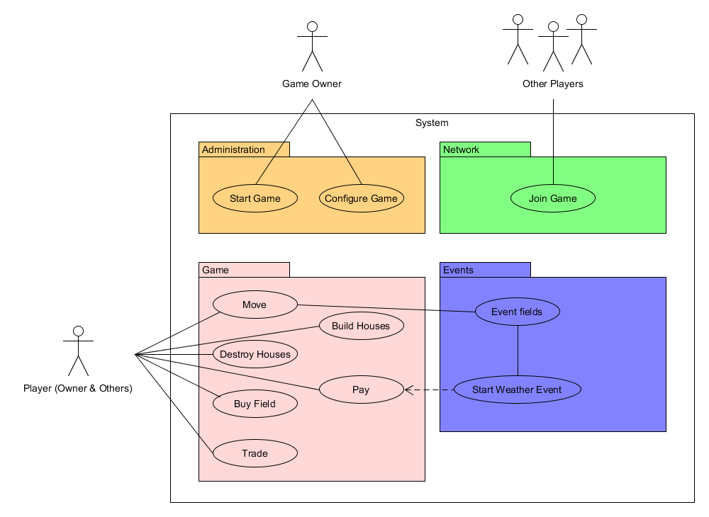
Use Case

Slide 7
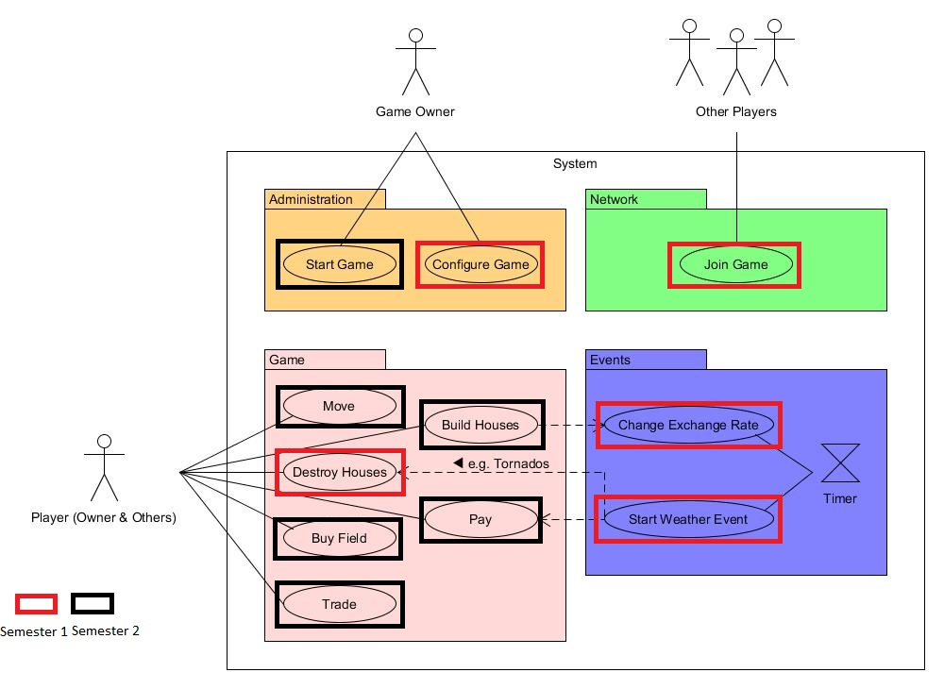

Slide 8
Scope
Playing Field
Surface
Trading
AI
Events

Slide 9
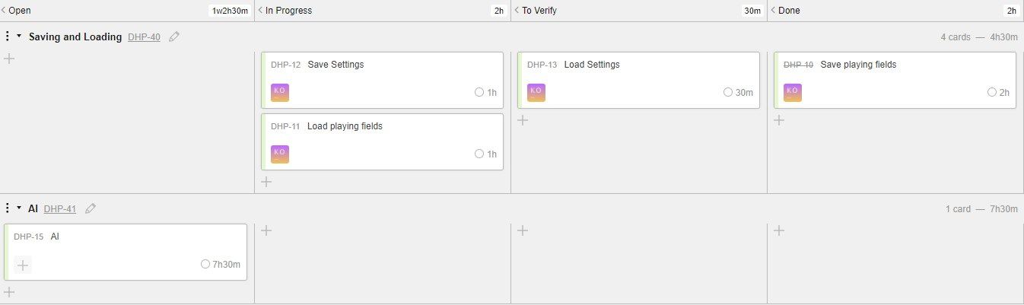
Scrumming

Slide 10
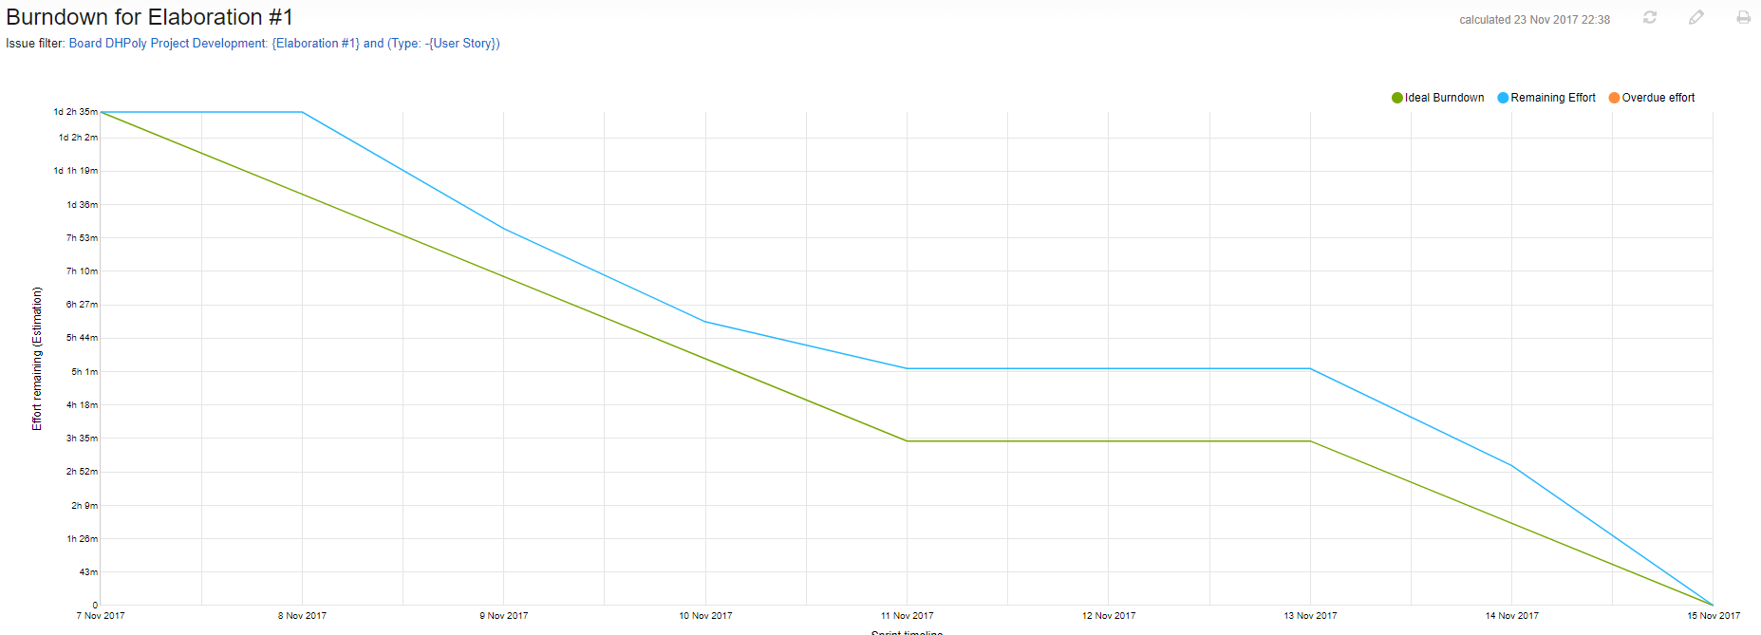
Burndown Chart: Week One

Slide 11
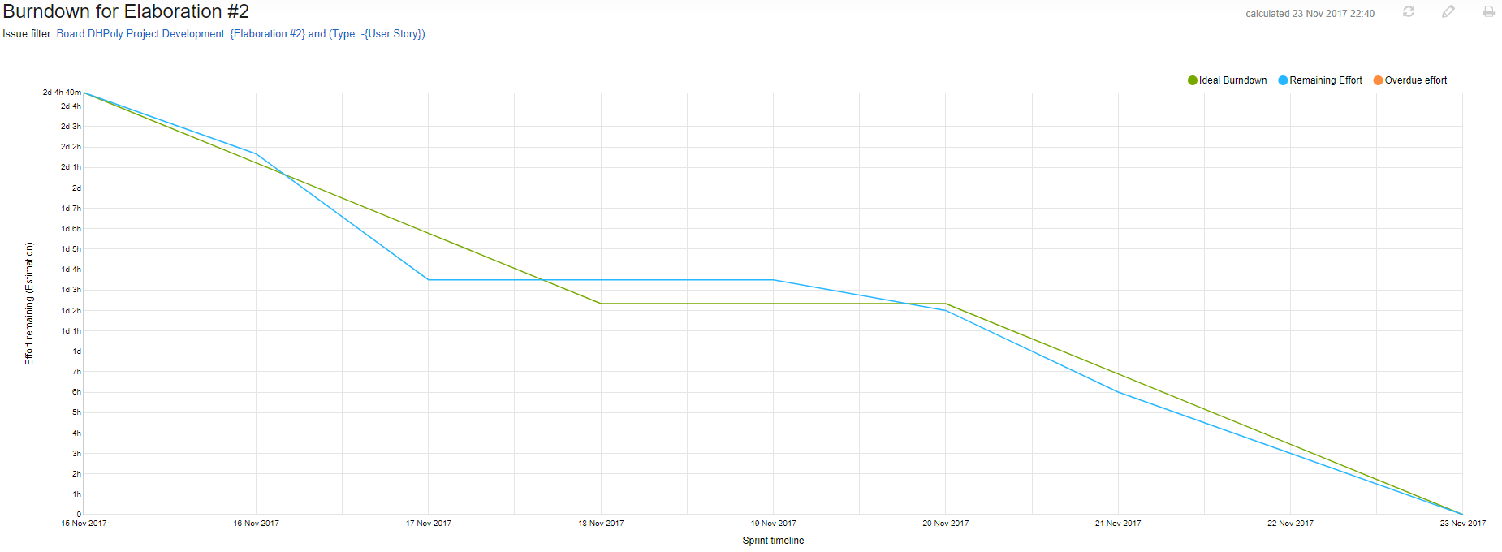
Burndown Chart: Week Two

Slide 12
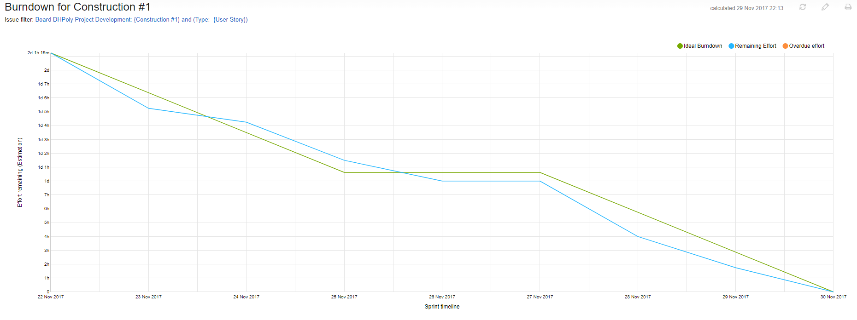
Burndown Chart: Week Three

Slide 13
Cost Estimation
Time estimated: 274h 50m
Time spent: i216h 40m

Slide 14
Project Methodology
Agile Project
Scrum
GitHub

Slide 15
Index
Business
Quality
Architecture
Tools
Risks
Testing
Metrics
Patterns
Technical Abilities

Slide 16
Architecture
Model
View
Control

Slide 17
Tools
Version Control
GitHub
Continues Integration
Jenkins
TeamCity
YouTrack

Slide 18
Tools
Testing
JUnit
Building Tools
Maven
Code Quality
Codacy
SonarLint
Code Climate
Documentation
Wordpress

Slide 19
Risks
No work
Timing
AI
Server
Quality
Licensing

Slide 20
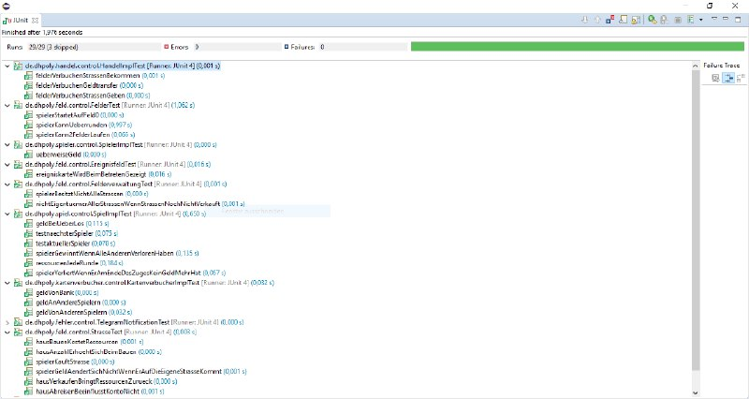
Testing

Slide 21
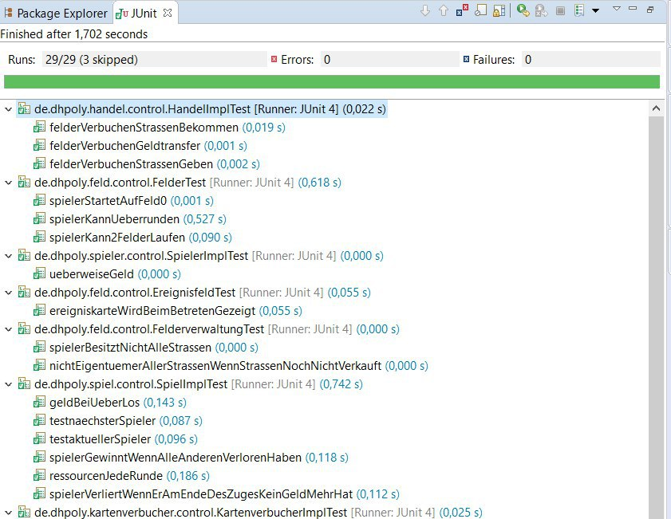

Slide 22
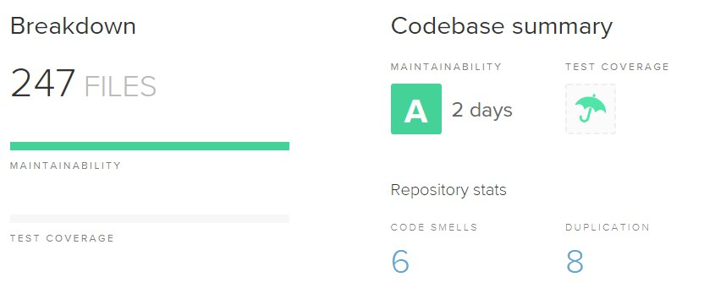
Codacy

Slide 23
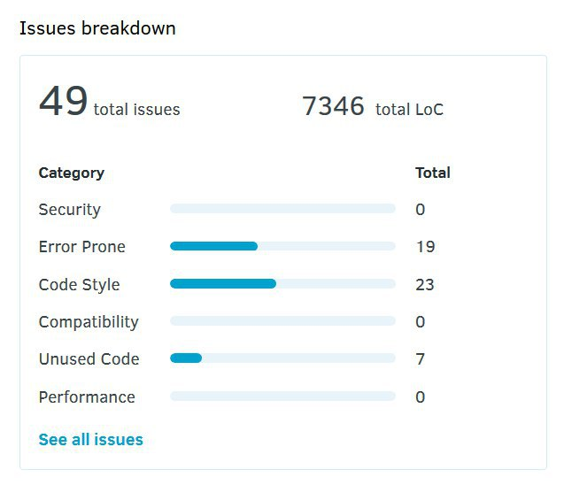
Code Issues

Slide 24
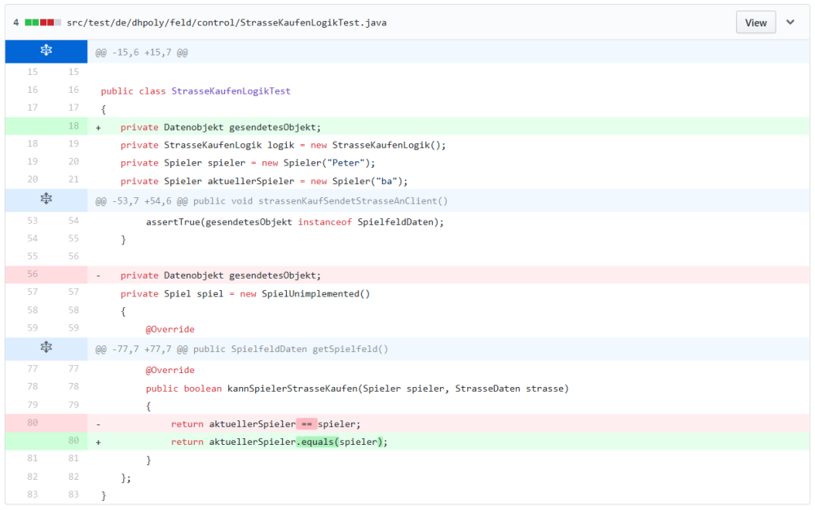
Code Refinement

Slide 25
Pattern
MVC
Factory

Slide 26
Index
Business
Quality
Technical Abilities
Class Diagram
Demo

Slide 27
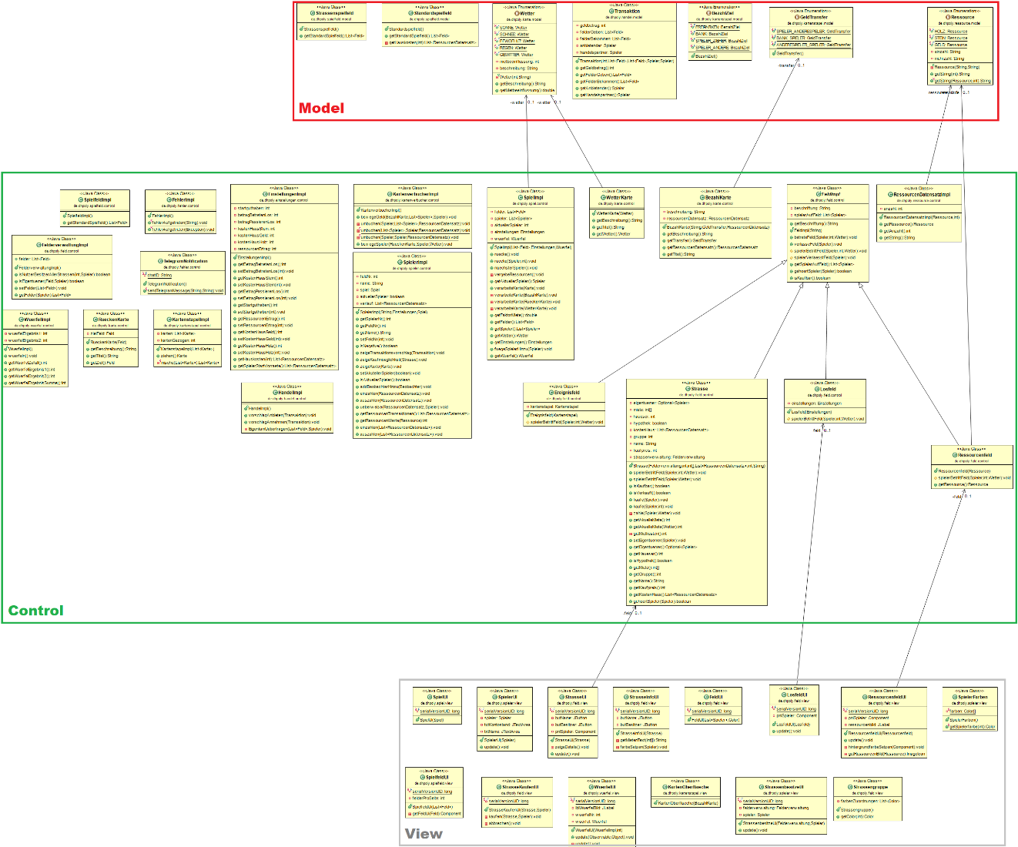
Class Diagram

Slide 29

Any Questions?

Slide 30
Thank you for your attention. We hope for good business in the future.

